Slide 1
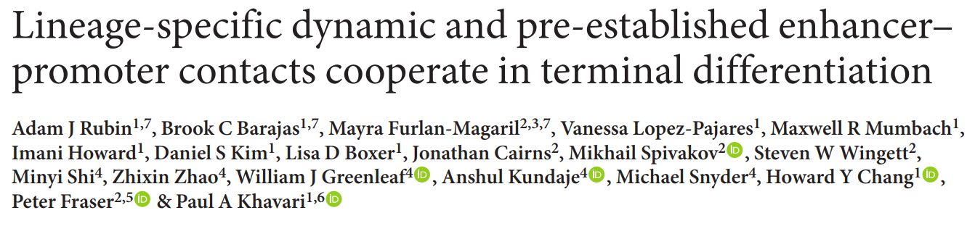
Chen Fengling
2018.08.04

Slide 2
Biological systems
epidermal differentiation in vitro (D0;D3;D6)
undifferentiated progenitor-containing cell populations (day 0)
early (day 3) late (day 6)
Data set
Hi-C (1.36 billion reads)
Promoter capture Hi-C (1.09 billion reads)
ATAC-seq
RNA-seq
ChIP-seq: KLF4 ZNF750 EHF H3K27ac
UMI-4C

Slide 3


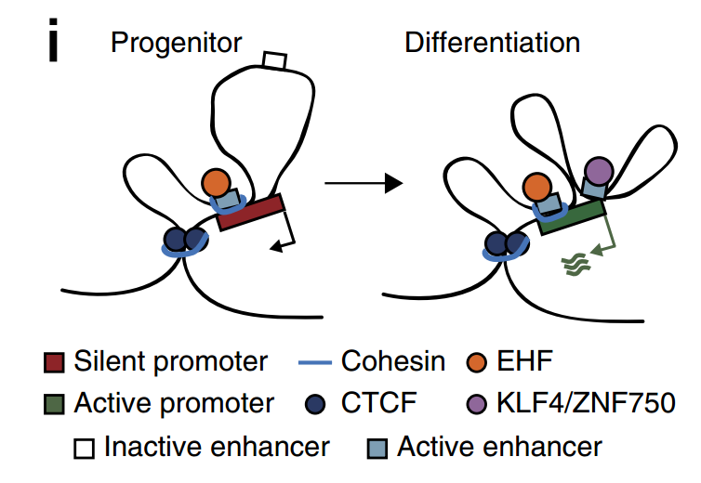
model
 |  | WT | EHFi
stable E-P | regulator | EHF (stable expressed)
 | contact | stable | not affected
 | H3K27ac | stable | not affected
 | differentiation-induced genes | induced | reduced
 |  | WT | KLF4i;ZNF750i
gained E-P | regulator | KLF4;ZNF750
 | contact | gained | reduced
 | H3K27ac | gained | reduced
 | differentiation-induced genes | induced | reduced

Slide 4
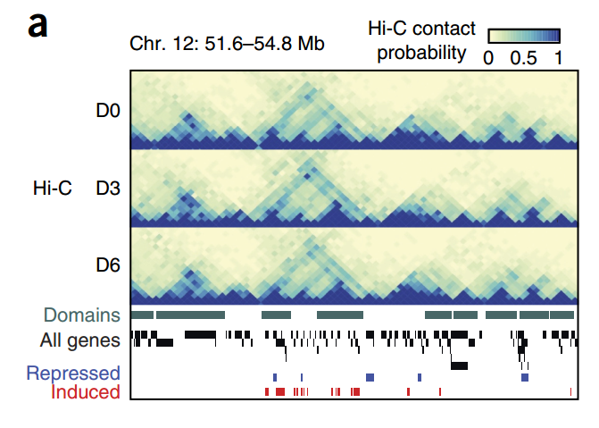
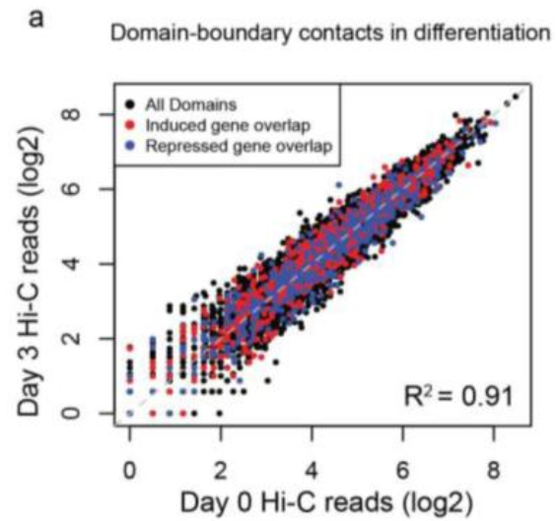
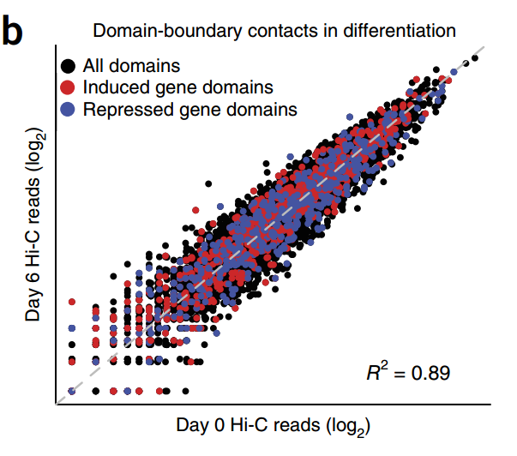
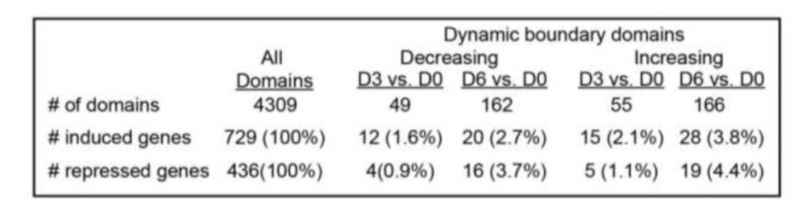
Domain boundary contacts
Domain boundary contacts were stable during differentiation
Regulatory dynamics occur via intra-domain contacts

Slide 5

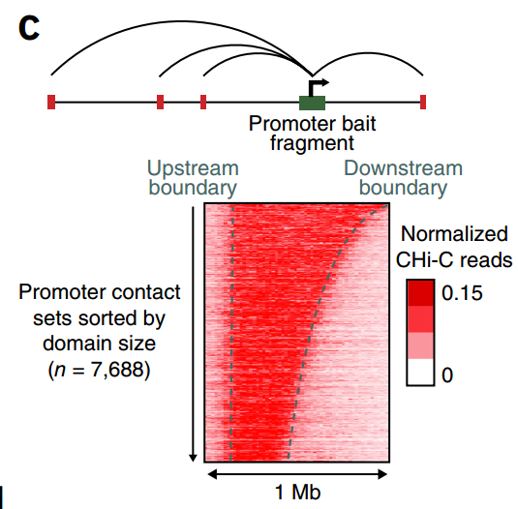
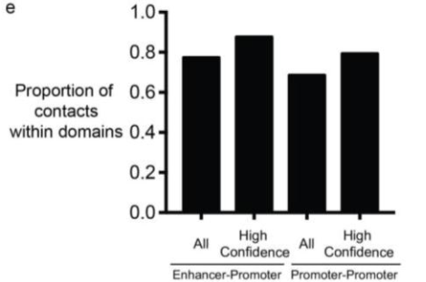
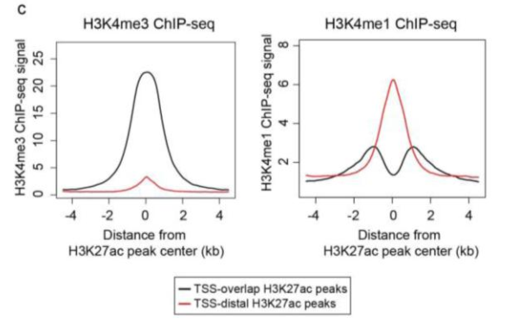
E-P contacts reside in TADs
putative enhancers
CHi-C identified 207,663 enhancer–promoter contacts and 89,752 promoter–promoter contacts
Both P-P and E-P contacts were largely restricted to single domains

Slide 6
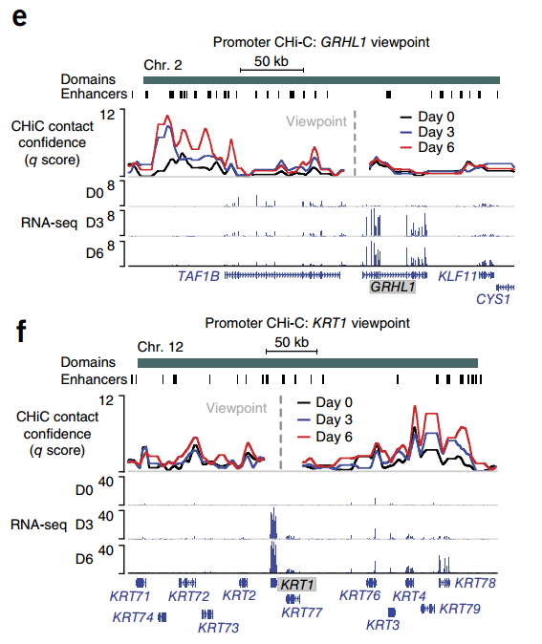

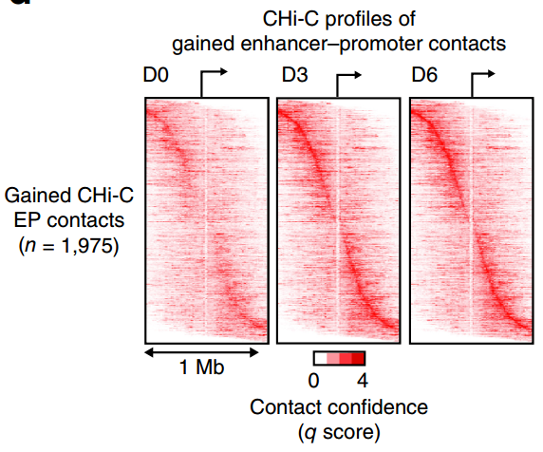
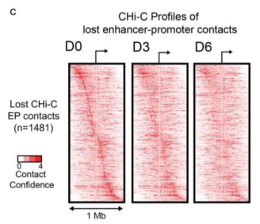
Contact changes
3,575 increased E-P contacts (>2-fold: 1,975)
3,207 decreased E-P contacts (>2-fold: 1,481)

Slide 7
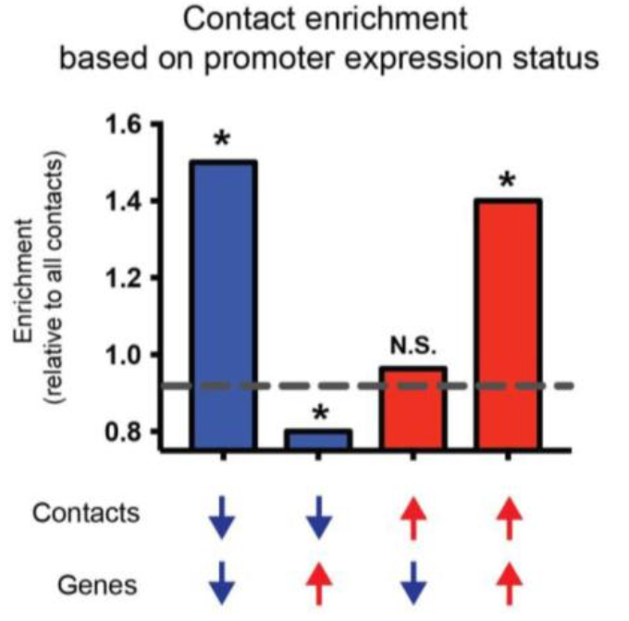
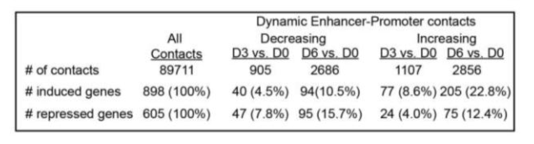
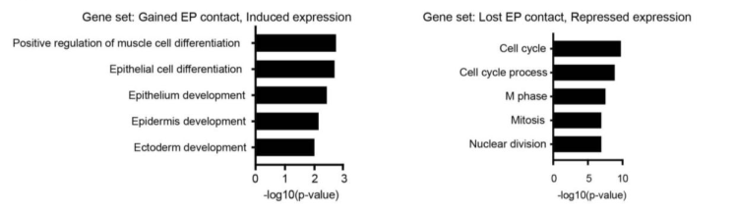
Contact changes and expression
global bias
increased contacts - differentiation-induced genes,
reduced contacts - differentiation-repressed genes
epidermal differentiation terms
progenitor state, such as proliferation

Slide 8
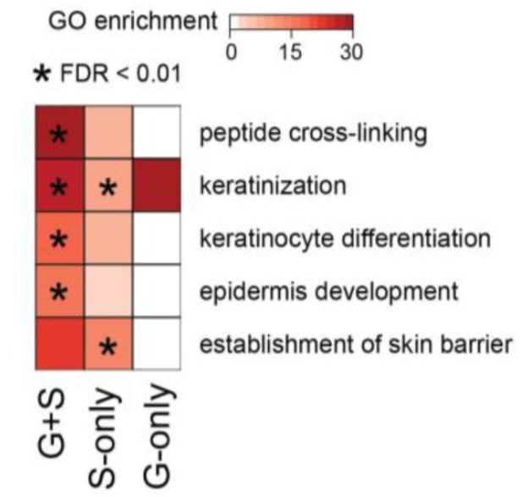
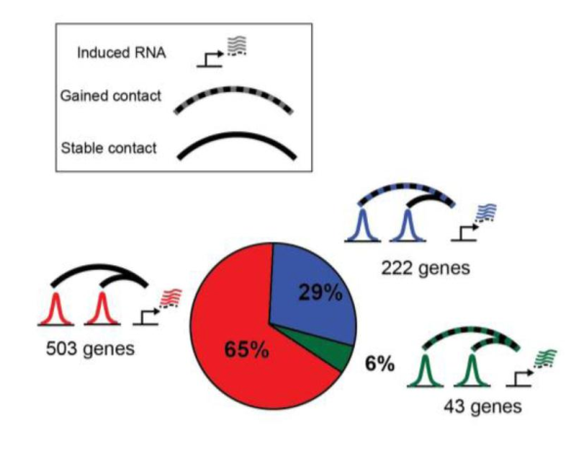
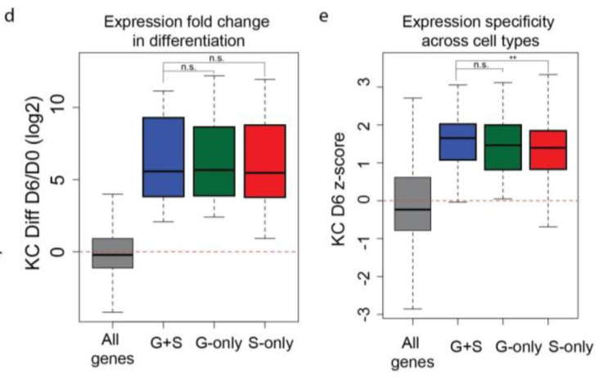
Induced genes engage in stable E-P contacts
differentiation genes within each category of E-P contacts had similar GO terms
tissue-invariant structural contacts form a universal architecture that guides tissue-specific enhancer–promoter interactions ??
GS or G genes exhibited more lineage-specific expression than S-only genes

Slide 9
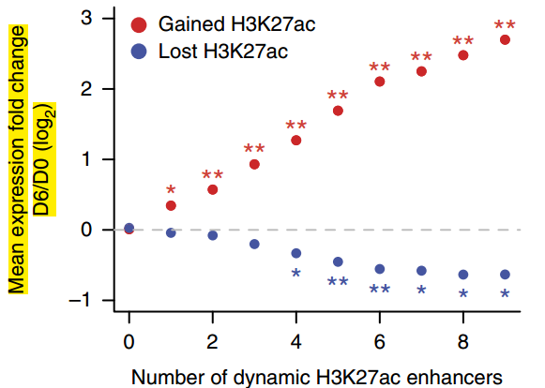
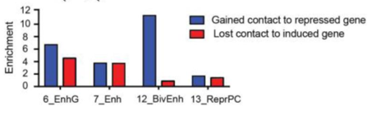
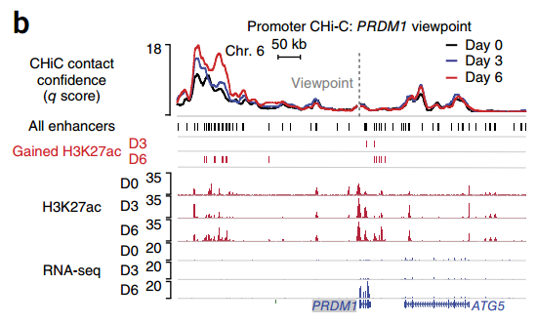
enhancer chromatin state; E-P contact; gene expression
gene induction ~ number of H3K27ac-gained enhancers
multiple classes of enhancers with distinct H3K27ac dynamics interact with a gene, not only to provide regulatory robustness but also to increase the magnitude of gene induction.

Slide 10
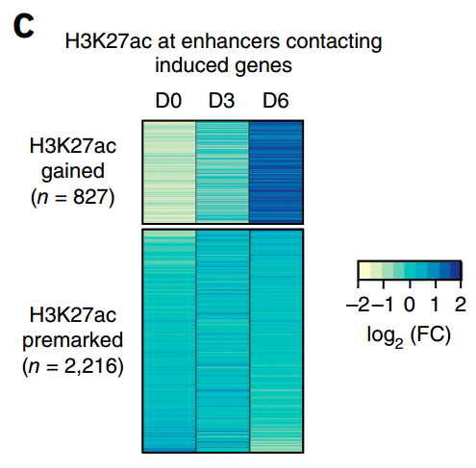
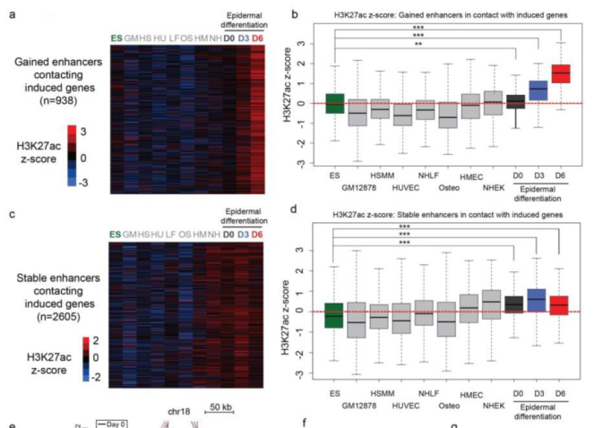
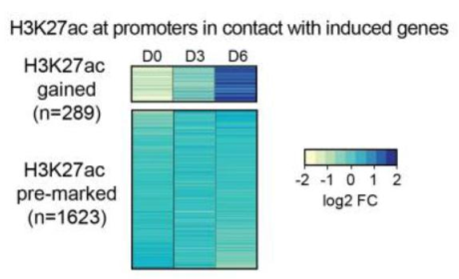
Lineage specificity of induced gene-linked enhancers
3,043 enhancers in contact with
differentiation-induced genes
stable enhancers and H3K27ac-gained enhancers were specifically marked by H3K27ac in keratinocytes

Slide 11
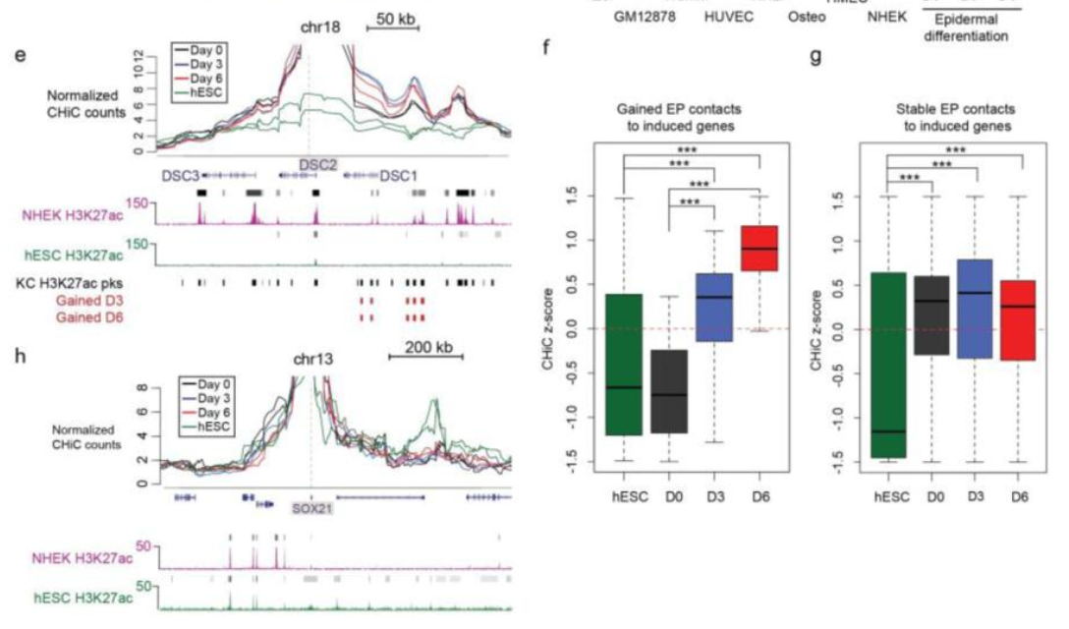
Some somatic E–P contacts is established after pluripotency but before induction of terminal differentiation genes
How to induce ??
both gained and pre-established enhancer–promoter contacts associated with differentiation genes showed significant reduction in signal in hESCs relative to kerationcytes, unlike the tissue-invariant contacts described in the mouse Hox loci.

Slide 12
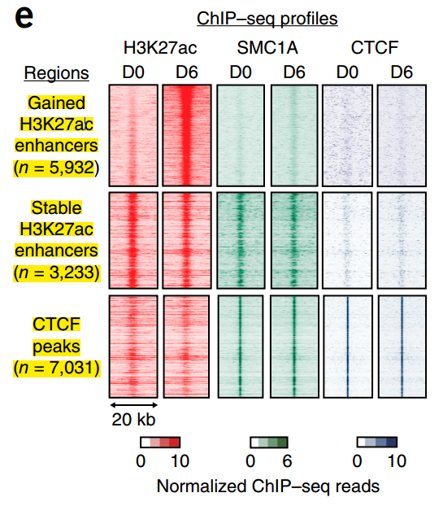
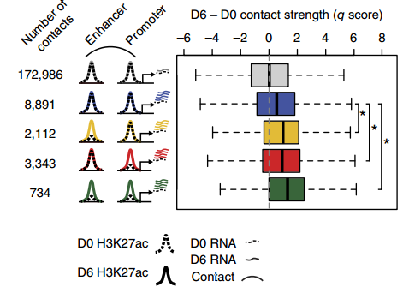
chromatin state activation and contact dynamics
gain of H3K27ac at an enhancer or promoter was associated with significant increases in contact strength

Slide 13
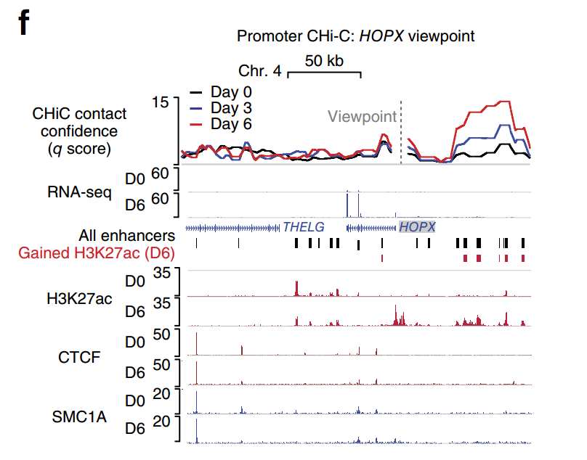
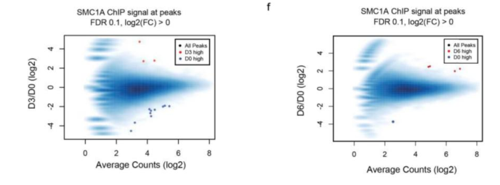
chromatin state activation and contact dynamics
Pre-established E-P contacts are associated with premarked H3K27ac and constitutive cohesin binding at enhancers
E–P contacts acquired in differentiation are associated with enhancers that gain H3K27ac and lack cohesin.

Slide 14
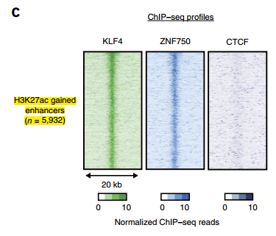
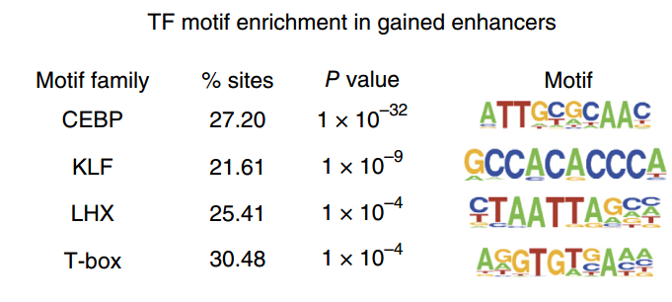
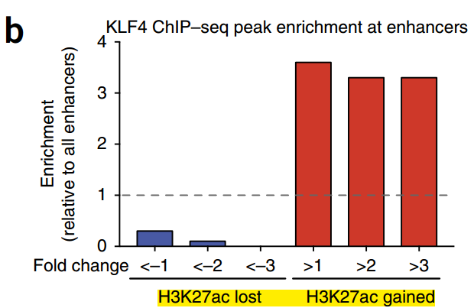
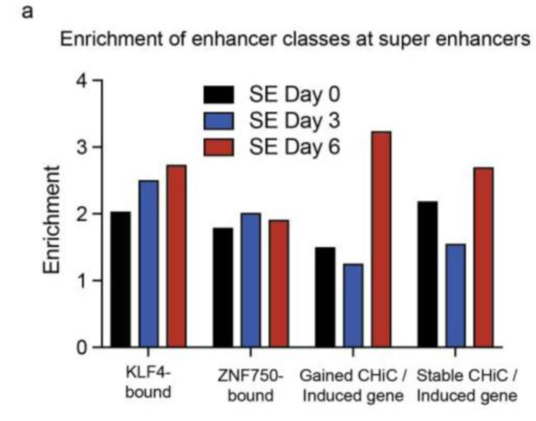
Gained enhancers and TFs
KLF4 binding was enriched at enhancers that acquired H3K27ac and depleted at enhancers that lost H3K27ac
KLF4- and ZNF750- bound enhancers also frequently overlapped super-enhancers

Slide 15
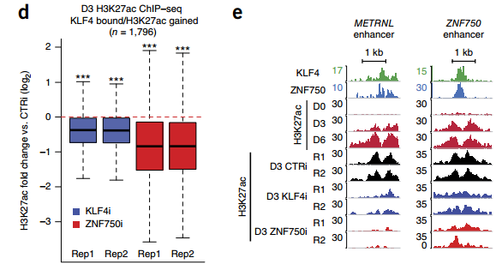
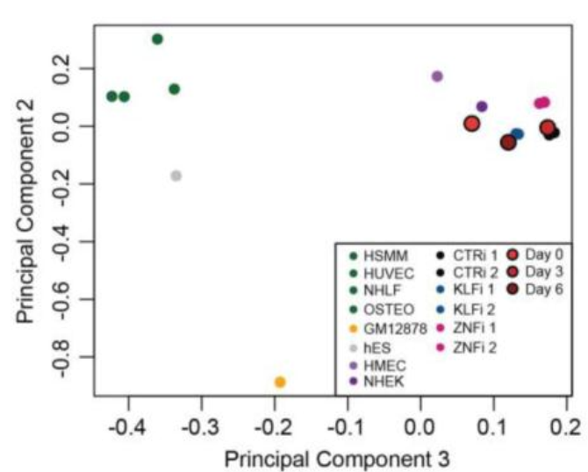
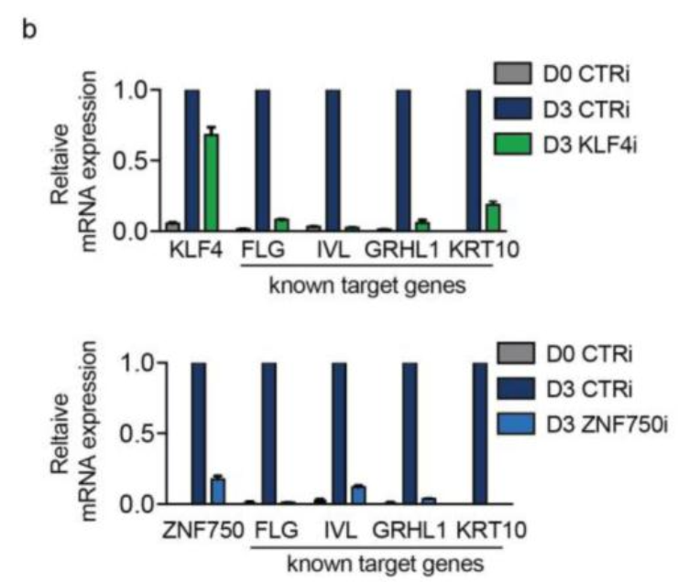
KLF4/ZNF750 contribute to enhancer activation and expression
Depletion of either factor impaired acquisition of H3K27ac at regions bound by these factors
transcription factor depletion altered epidermal differentiation but did not alter epidermal identity

Slide 16
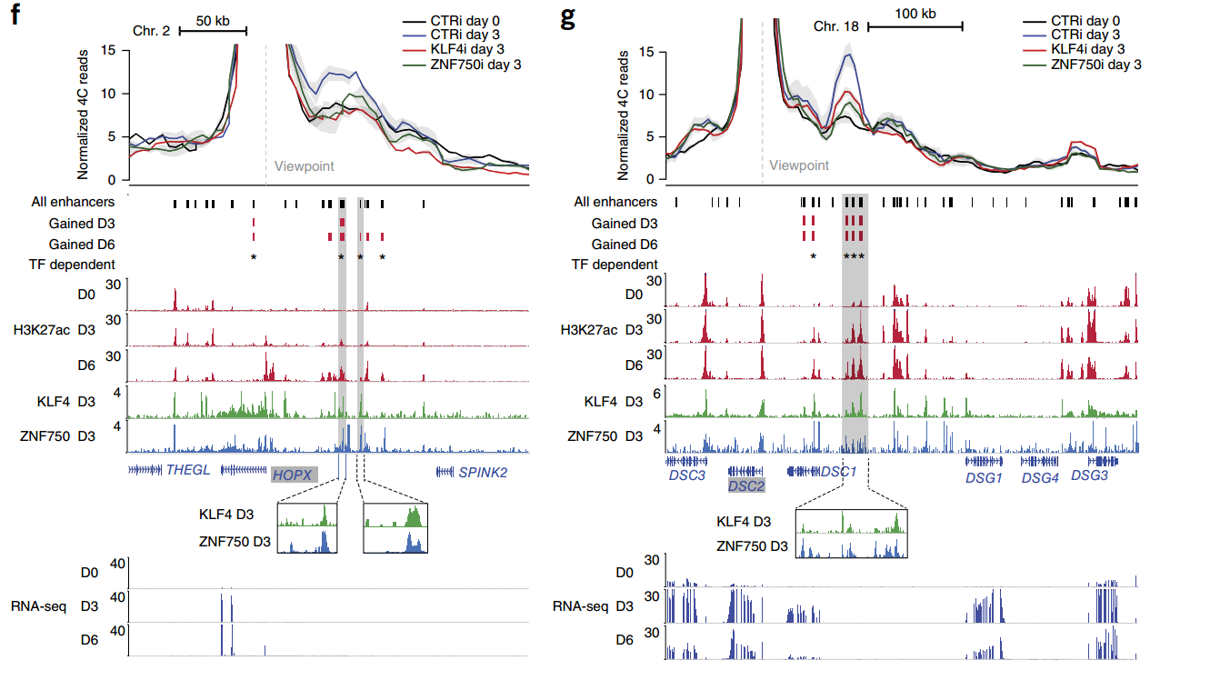
KLF4/ZNF750 influence E-P contacts
Depleting KLF4 or ZNF750 decreased contact strength.
function at a subset of enhancers targeting induced genes

Slide 17
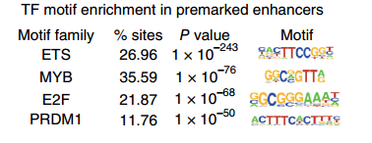
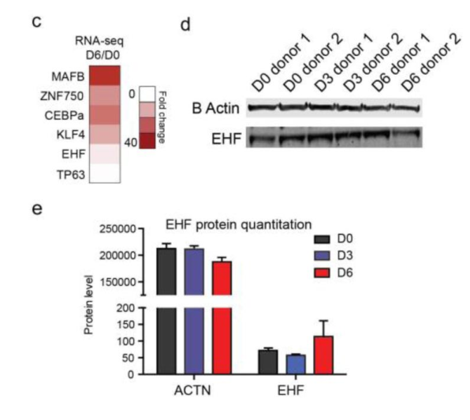
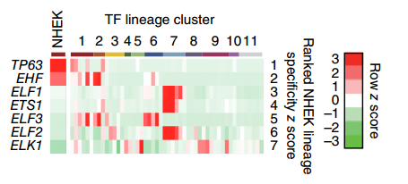
Stable enhancers and TFs
Why not these fators
?
EHF expression was largely stable during differentiation
The EHF ETS-family transcription factor showed the most lineage-specific expression in stratified epithelia

Slide 18
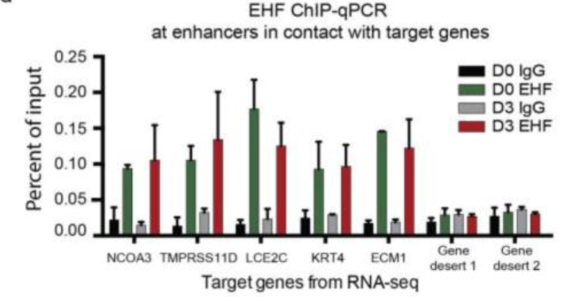
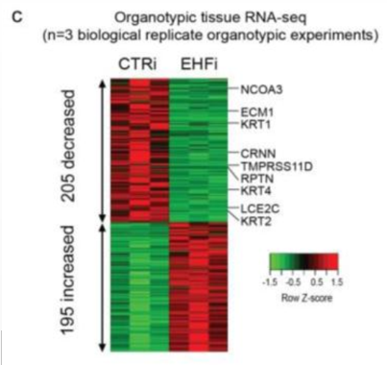
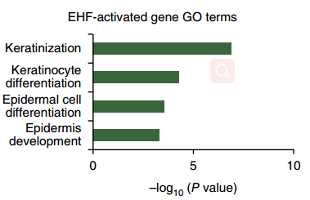
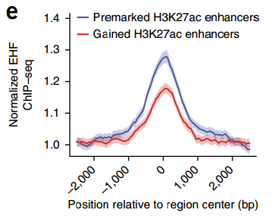
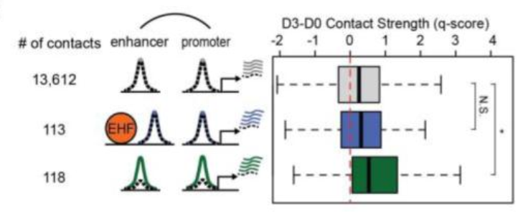
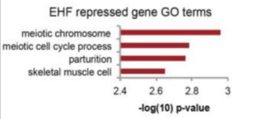
EHFi
EHF binding at induced genes remained stable
EHF-bound, H3K27ac-premarked enhancers generally engaged in stable contacts with differentiation-associated genes
EHF is required both for induction of differentiation-related genes and for repression of ectopic gene expression.

Slide 19
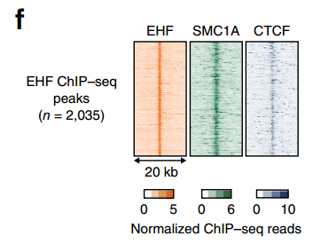
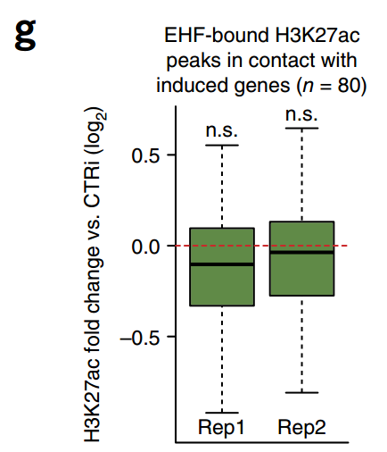
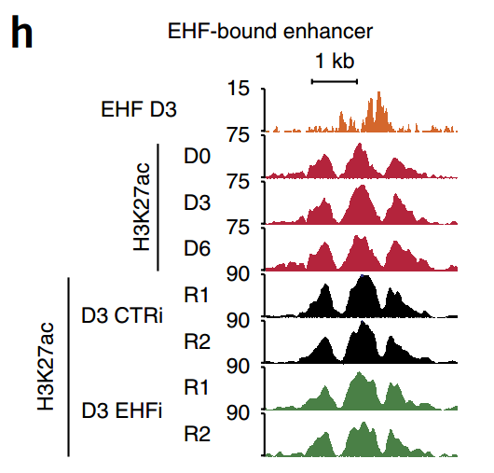
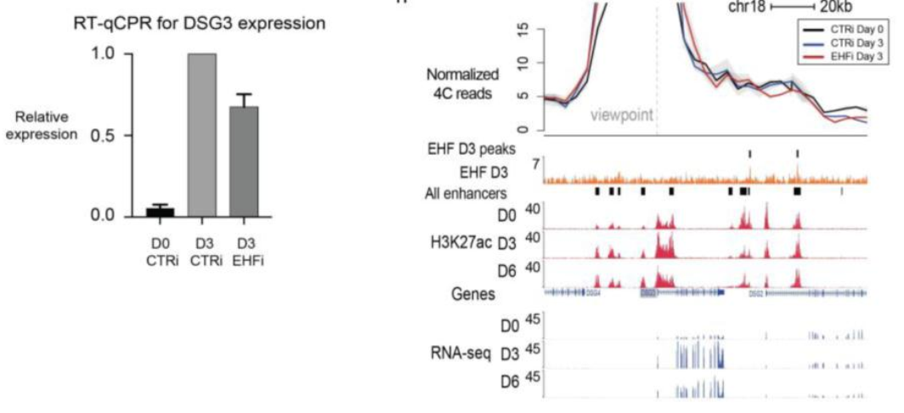
EHFi
EHF regulates gene expression in a manner distinct from KLF4 and ZNF750

Slide 20
Summary
 |  | WT | EHFi
stable E-P | regulator | EHF (stable expressed)
 | contact | stable | not affected
 | H3K27ac | stable | not affected
 | differentiation-induced genes | induced | reduced
 | cohesin colocalized | Yes
 |  | WT | KLF4i;ZNF750i
gained E-P | regulator | KLF4;ZNF750 (induced)
 | contact | gained | reduced
 | H3K27ac | gained | reduced
 | differentiation-induced genes | induced | reduced
 | cohesin colocalized | Yes
Progenitor cells partially pre-establish a regulatory apparatus that is fully engaged in terminal differentiation.

Slide 21
comments
the differentiation-repressed genes ? (contact loss)
CTCF-mediated loop changes, relation with gene expression? relation with TF-mediated E-P interaction?
Casual relation of looping and expression changes? (editing some enhancer region)

Slide 22
THANK YOU

